Slide 1
Draftkings lineup optimizer

Slide 2
Problem definition
What is DraftKings?
Users compete in contests for money by selecting players they think will outperform other players on a given day.
What is the goal?
Build a supervised machine learning model that provides an advantage over the competition to remain profitable over time.

Slide 3
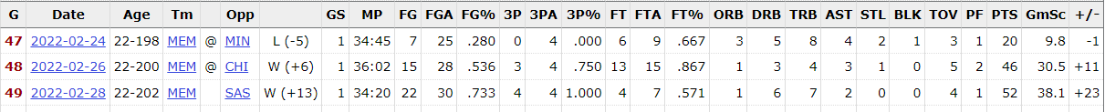
Data
Data collection
Used selenium to scrape player statistics, player salaries
Stored stats in postgres database using Valentina Studio
What kind of data?
Structured data
Static & Streaming
Data cleaning and exploration
Used pandas and numpy libraries for data cleaning and merging of datasets
Used plotly to explore the data
https://www.basketball-reference.com/players/m/moranja01.html

Slide 4
Project framework
Evaluation
The evaluation metric for this project is the RMSLE (Root Mean Squared Log Error).
The goal is to minimize the RMSLE to get the most accurate predictions, but not penalize huge outliers significantly since there are many factors which could result in significant outliers.
Features
Categorical Features - Team, position, etc
Numerical Features - Points, assists, rebounds, etc
Modelling
Regression model used for predicting specific numbers.
Experimentation
Used 70% for training set, 10% for validation set, and 10% for test data.

Slide 5
The process
Cleaning and Exploration
Removed games where player DNP
Merged data from DraftKings salaries on a given night and the player’s actual performance on that night
Visualized various stats and their correlation
Feature Engineering
Generated additional features (fantasy points, recency effect, etc)
Weighting (Home/Away, recency effect, etc)
Remaining Challenges
Various factors such as what players are playing/not playing on a given night
Last second roster changes

Slide 6
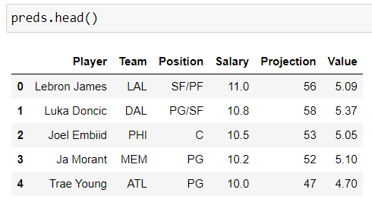
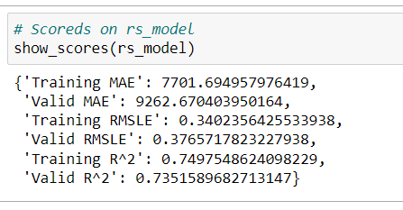
outcomes
Evaluation
The model does a fairly good job of predicting a player’s points on a given night with a validation RMSLE of 0.38.
Findings
Creating accurate predictions of player’s scores is not enough to guarantee a high finish in competitions.
Large field of competitors using predictive models
My results
I have been able to sustain a profitable strategy over time using these predictions (Up ~$15k over 3 years)
Future updates
Automate the lineup building process
Include more abstract features such as who the referees are or the importance of a game to their team

Slide 7
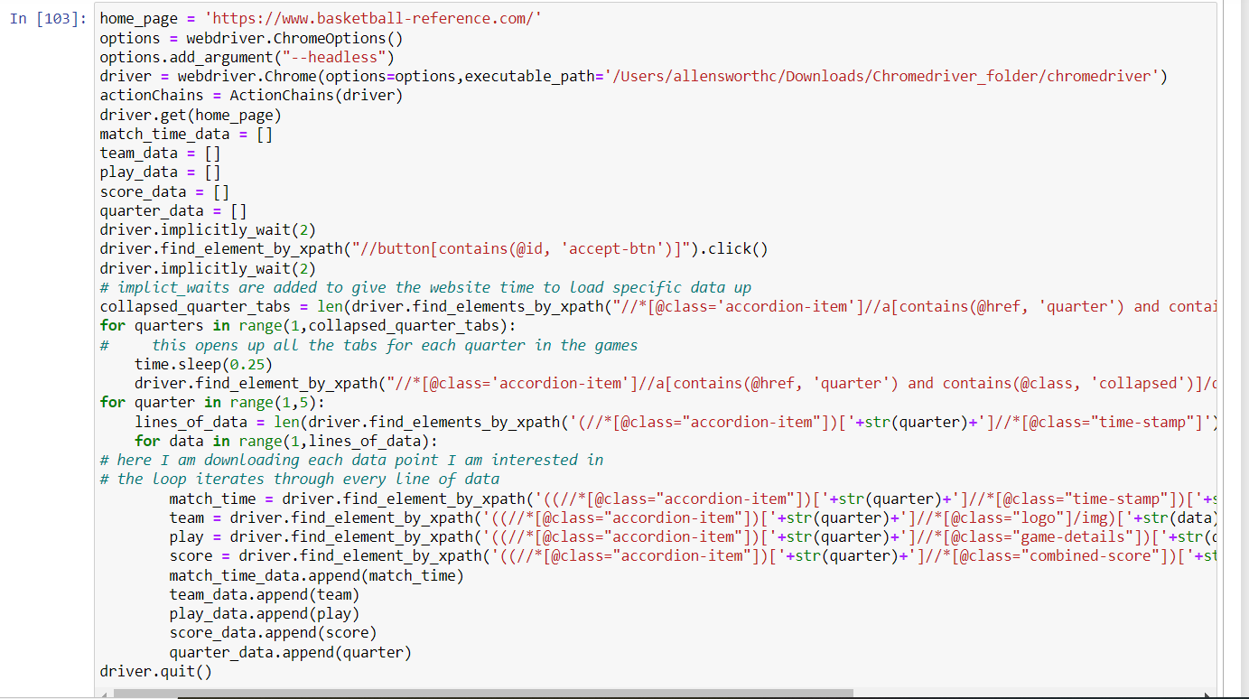
Scraper

Slide 8
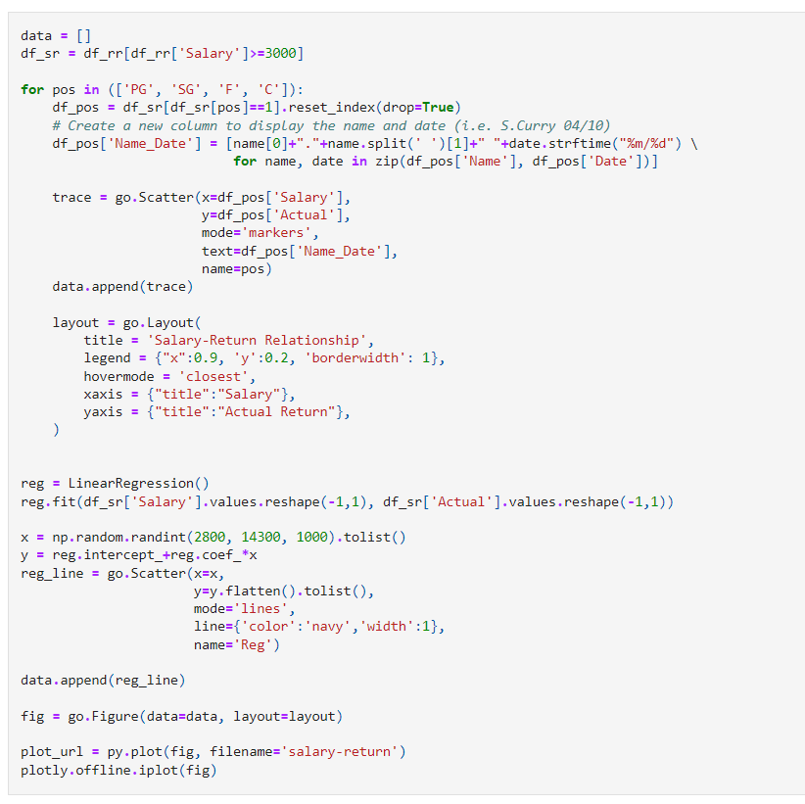
exploration

Slide 9
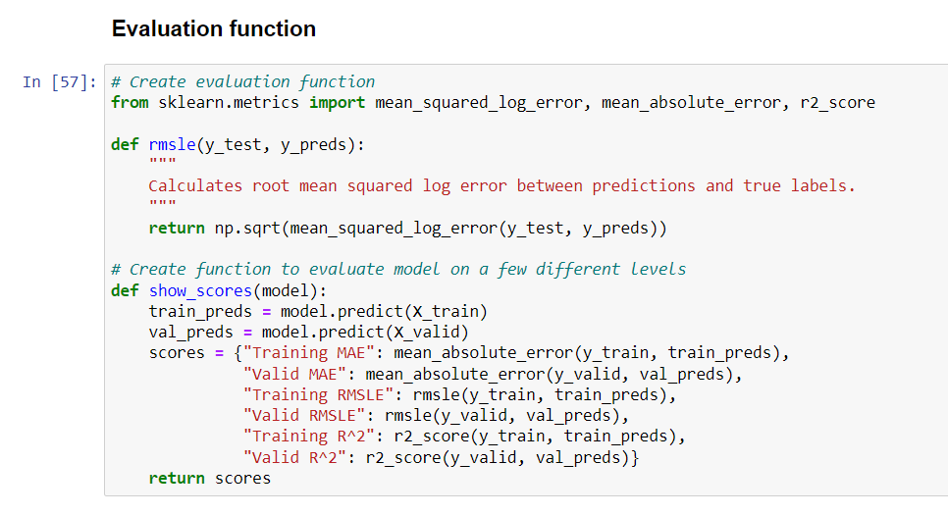
Evaluation function

Slide 10
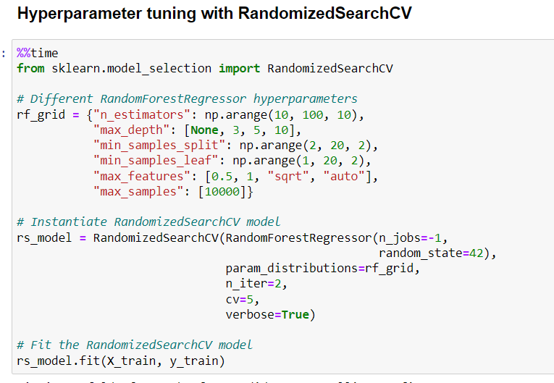
Hyperparameter tuning

